Slide 1
Blockchain-Based Skill Credentialing System
CSE7302- University Project
Final Review
Batch Number: CBC_5
Under the Supervision of,
Mr. Shankar J Assistant Professor
School of Computer Science and Engineering
Presidency University
20221CBC0019 | NIKITHA S
20221CBC0020 | VINUTA JANARDHAN HEGDE
20221CBC0048 | SANDYA KJ
Roll Number | Student Name
Name of the Program: Bachelor of Technology
Name of the HoD: Dr. Pravinthraja S
Name of the Program Project Coordinator: Dr. H M Manjula
Name of the School Project Coordinators: Dr. Sampath A K

Slide 2
Content
Problem Statement
Proposed Solution
Objectives
System Architecture
Algorithm Details
Advantages
Challenges & Solution
Github Link
Conclusion & Future Scope
References

Slide 3
Problem Statement Number: SIH25200
Organization: Presidency University
Category: Software
Problem Description: Fake and unverifiable skill certificates have become a major challenge in education and employment sectors. Traditional certificate systems are centralized, prone to forgery, and require manual verification, which is time-consuming and unreliable. Employers face difficulty in instantly validating candidate skills, while students struggle with portability and authenticity of credentials.
This project aims to develop a Blockchain-Based Skill Credentialing System that provides secure, tamper-proof, and instantly verifiable digital skill certificates.

Slide 4
Problem Statement Fake skill certificates are a serious problem today. Existing systems are slow, centralized, and easy to forge. This project proposes a Blockchain-Based Skill Credentialing System to provide secure and instantly verifiable digital certificates.

Slide 5
Objectives
Issue secure digital skill credentials
Prevent fake or duplicate certificates
Enable instant employer verification
Ensure tamper-proof certificate storage using blockchain
Support multi-institution and training provider integration
Maintain privacy by storing only hashes on blockchain

Slide 6
Literature Survey
[1] Wang et al., 2025
Proposes a blockchain-based system for issuing and verifying academic and skill credentials.
Uses cryptographic hashing and smart contracts to ensure certificate immutability.
Significantly reduces verification time compared to traditional systems.
[2] Kumar & Patel, 2025
Focuses on decentralized skill certification for online and professional training.
Implements smart-contract-based issuance and revocation of certificates.
Improves trust and interoperability across institutions.

Slide 7
Literature Survey
[3] Fernández et al., 2025
Introduces a privacy-preserving blockchain credential management framework.
Stores certificate data off-chain while keeping verification logic on-chain.
Enhances scalability and protects sensitive personal information.
[4] Nakamura & Ishikawa, 2025
Presents a secure and scalable blockchain framework for digital skill credentials.
Addresses performance and storage challenges in large-scale systems.
Demonstrates reliable and tamper-proof verification.

Slide 8
Literature Survey
[5] Hasan & Salah, 2025
Proposes a blockchain-based solution for employment-oriented skill certification.
Enables instant employer-side verification using decentralized ledgers.
Reduces fraud and dependence on centralized authorities.

Slide 9
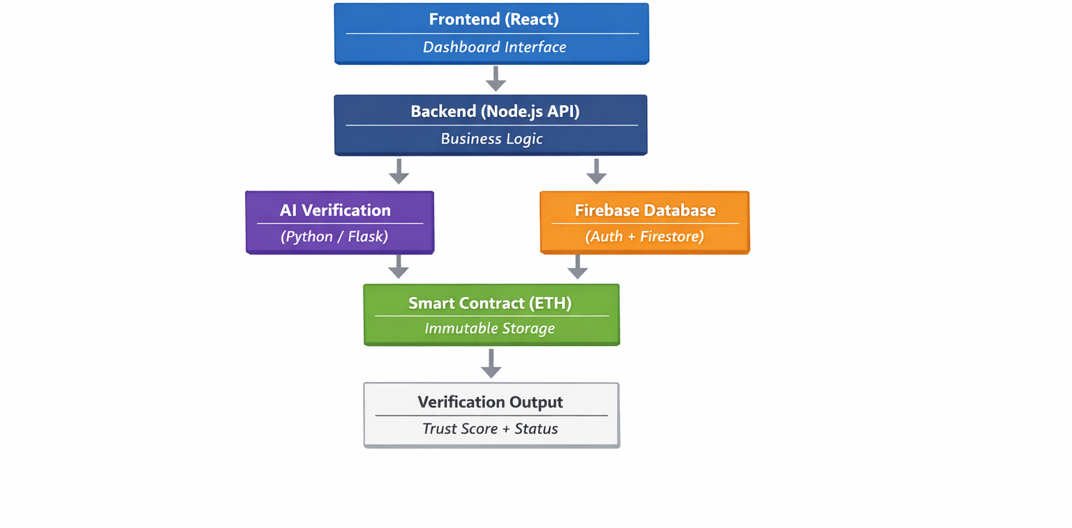
Architecture

Slide 10
Algorithm Details
Algorithm | Purpose | Core Process | Output
Keccak-256 Hashing | Generate tamper-proof certificate ID | Certificate Data → keccak256() → 256-bit Hash | Unique Blockchain Hash
ECDSA (Digital Signature) | Secure certificate issuance | Tx Data → Sign (Private Key) → Verify (Public Key) | Authenticated Transaction
Smart Contract Mapping | Fast certificate storage & lookup | Hash → Store in mapping(bytes32 => Certificate) | Instant Verification
AI Trust Score (CNN) | Detect fake certificates | Image → CNN Analysis → Score (%) | Genuine / Flagged
Skill-Job Matching (NLP) | Match students to jobs | Skills + JD → Embeddings → Cosine Similarity | Ranked Candidates
Ethereum PoS Consensus | Validate blockchain transactions | Tx → Validators → Block Confirmation | Finalized Record

Slide 11
Advantages
Tamper-Proof Certificates
Uses Keccak-256 hashing + Blockchain storage, making certificates immutable and impossible to alter.
Instant Verification
Employers can verify certificates in seconds using QR code + blockchain hash comparison.
Fraud Detection with AI
CNN-based Trust Score system detects fake or manipulated certificates before blockchain entry.
Secure & Transparent System
Uses ECDSA digital signatures + Ethereum PoS, ensuring authenticity and secure transactions.
Skill-to-Job Matching
NLP-based matching automatically connects verified student skills to relevant job descriptions.
Automated Resume Generation
AI generates ATS-friendly resumes using only blockchain-verified skills, increasing job opportunities.

Slide 12
Challenges & Solutions
Challenge | Impact | Solution Implemented
High Gas Fees | Expensive blockchain storage | Store only Keccak-256 hash on-chain; keep certificates in IPFS/backend
Certificate Fraud | Fake or tampered documents | AI-based Trust Score (CNN model) before blockchain upload
Private Key Security | Risk of unauthorized transactions | MetaMask off-chain ECDSA signing to protect private keys
Skill Mismatch | Employers struggle to find suitable candidates | NLP-based Skill-to-Job Matching using cosine similarity
Slow Manual Verification | Time-consuming background checks | QR-based instant blockchain verification
Scalability Issues | Network congestion & delays | Use Ethereum PoS/Testnet deployment for efficiency

Slide 13
Github Link
Github Link
https://github.com/Niki-19/SIH25200-Blockchain-Skill-Credentialing
Data Set
https://share.google/TiwMpCPRnaYXj7hNf

Slide 14
Conclusion & Future Scope
Conclusion
Built a secure, tamper-proof blockchain credential system.
Integrated AI for fraud detection & job matching.
Reduced verification time and increased trust.
Future Scope
Deploy on Mainnet / Layer-2 networks.
Integrate with universities & government portals.
Improve AI accuracy with larger datasets.
Launch mobile app & cross-chain support.

Slide 15
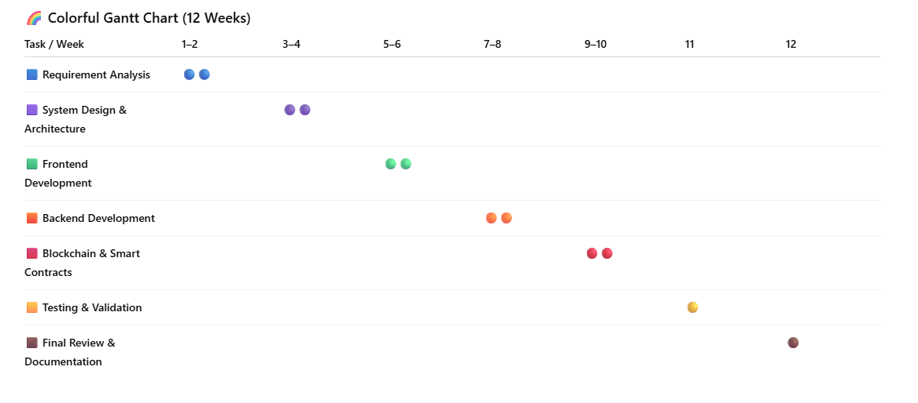
Timeline of the Project (Gantt Chart)

Slide 16
References (IEEE Paper format)
[1] J. Wang, X. Li, and Y. Chen, “Blockchain-Based Digital Credential Verification System for Education and Employment,” arXiv preprint arXiv:2502.09431, 2025.
[2] A. Kumar and S. Patel, “Decentralized Skill Certification Using Blockchain and Smart Contracts,” arXiv preprint arXiv:2503.11782, 2025.
[3] L. Fernández, M. López, and R. García, “Privacy-Preserving Academic Credential Management Using Blockchain,” arXiv preprint arXiv:2501.06354, 2025.
[4] S. Nakamura and T. Ishikawa, “Secure and Scalable Blockchain Framework for Digital Skill Credentials,” in Proc. 2025 IEEE Int. Conf. on Blockchain and Cryptocurrency (ICBC), Sydney, Australia, 2025, pp. 214–221.
[5] R. Hasan and K. Salah, “Blockchain-Based Skill Certification for Trustworthy Employment Verification,” IEEE Access, vol. 13, pp. 45210–45225, 2025.

Slide 17


